Slide 1


Economic Analysis: U.S. States since the 2008 Recession

Slide 2
1. Determine which states were the most/least affected by the 2008 Recession and which recovered the best/worst 2. Test factors that we think correlate with the most/least affected states.
Objective:
Method:
Two indicators:
1. Change in State GDP by year
2. Change in Unemployment rate by year
Datasets were .csv files from data.gov & census.gov

Slide 3
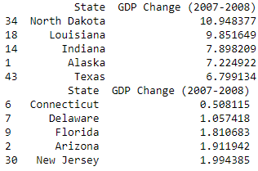
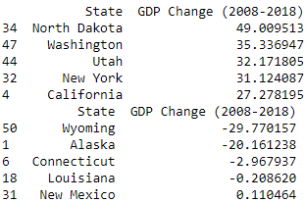
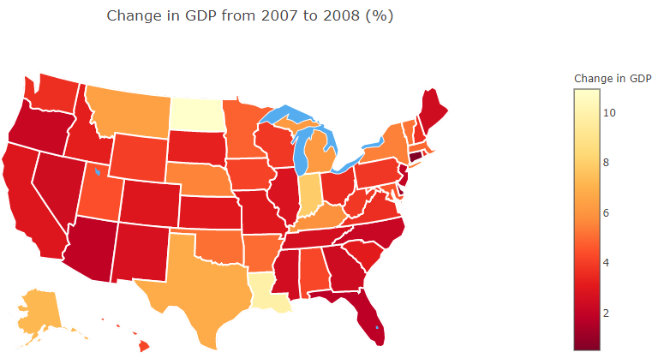
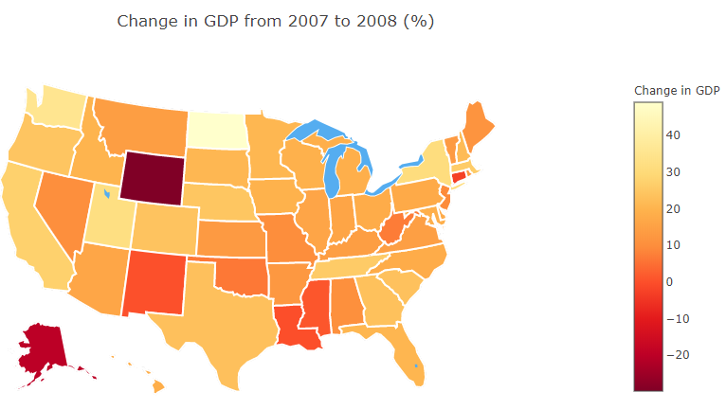
State GDP Changes

Slide 4
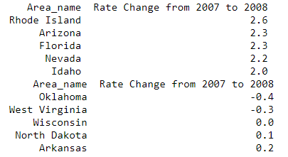
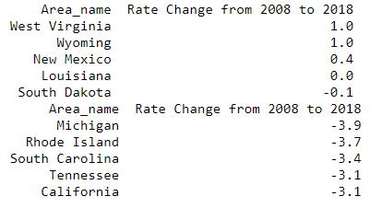
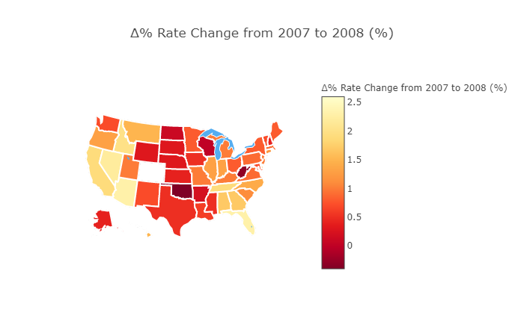
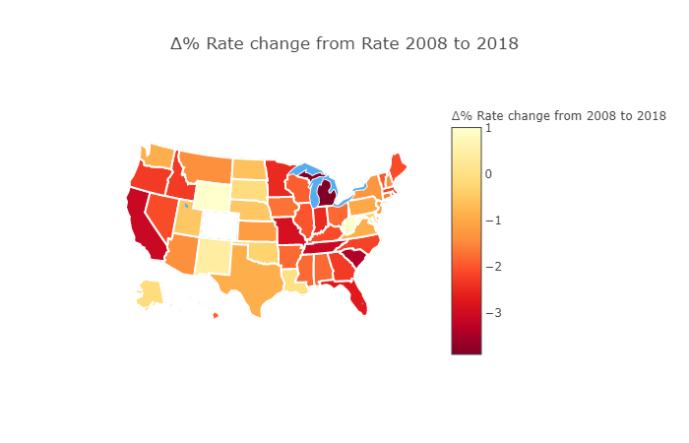
Unemployment Rate Changes

Slide 5
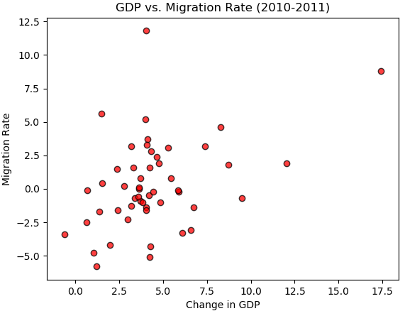
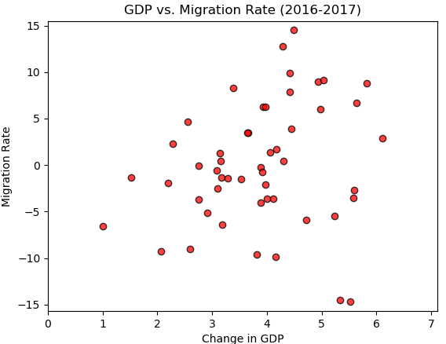
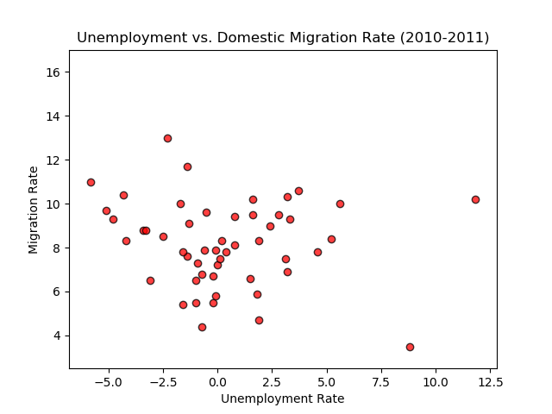
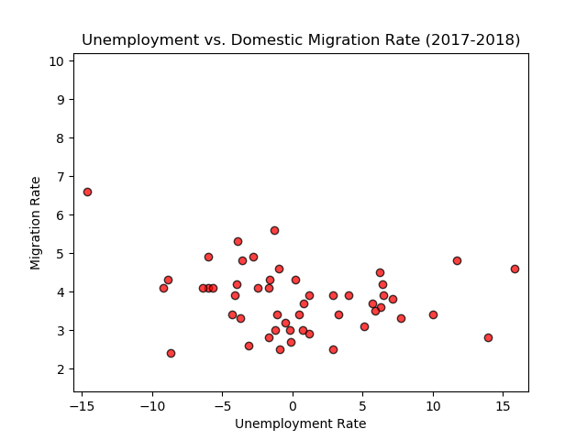
Migration Rates vs. Changes in GDP and Unemployment Rates

Slide 6
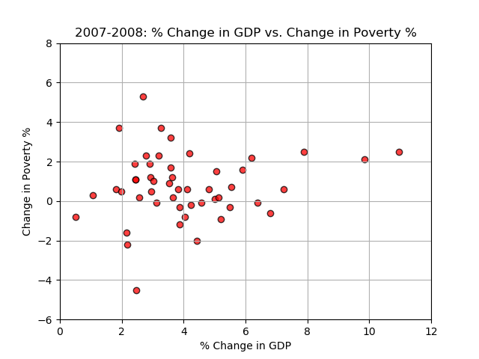
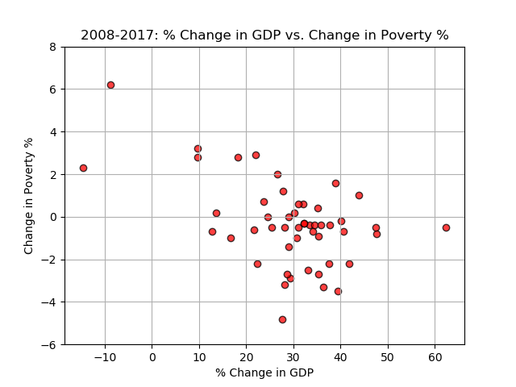
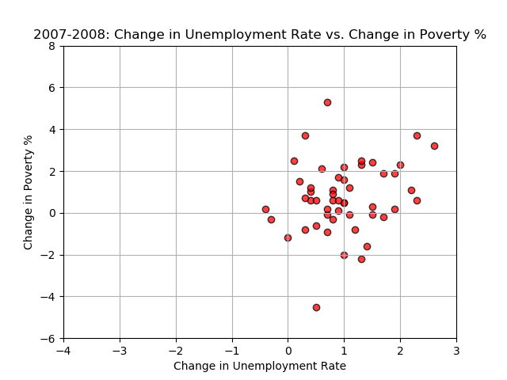
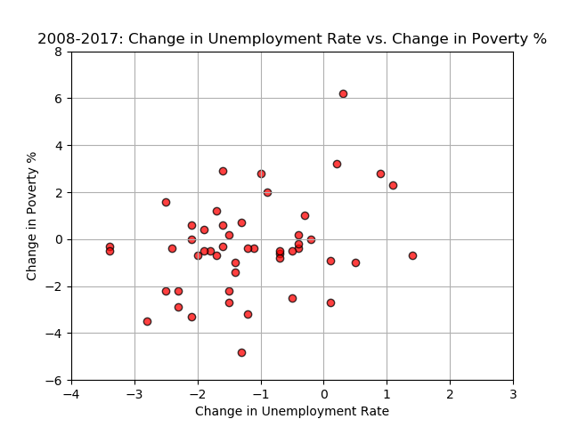
Poverty Rates vs. Changes in GDP and Unemployment Rates

Slide 7
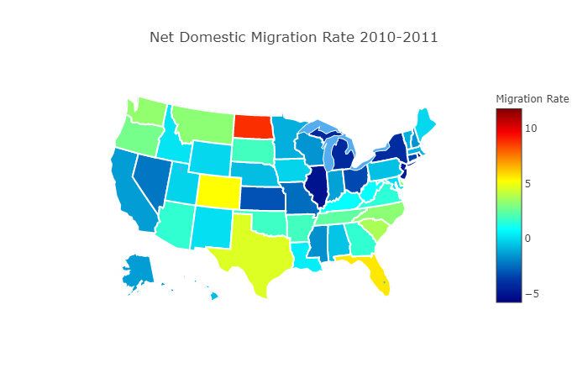
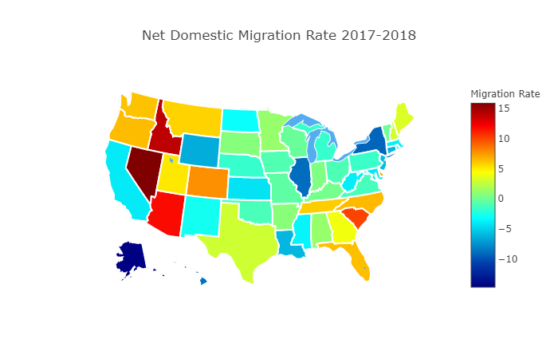
Net Domestic Migration Rate 2010-11 & 2017-18

Slide 8
Summary
Charlie summarize slide
Ayrton summarize slide
Sai summarize slide
Zach summarize slide

